Slide 1

HOW DO WE CONDUCT ECONOMIC CENSUSES
Benito Arciniega Castro
Coordinator of Conceptual Design and Economic Studies
September 3rd, 2025

Slide 2

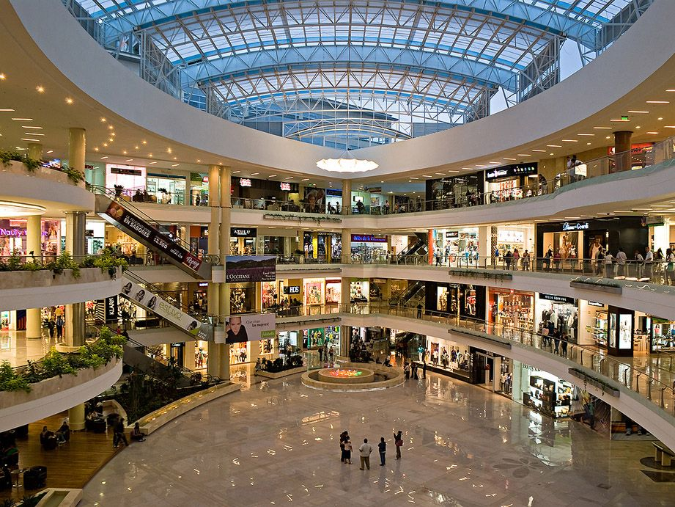

WHAT ARE ECONOMIC CENSUSES?
The most comprehensive and detailed source of basic economic information in Mexico.
They collect information from all establishments that produce goods, market merchandise, and provide services in order to generate economic indicators for the country at a high level of geographical, sectoral, and thematic detail.
Necessary for decision-making, analysis, and research in the social, public, private, and academic sectors.

Slide 3








SINCE 1930, MEXICO HAS CONDUCTED ECONOMIC CENSUSES
EVERY FIVE YEARS
More than 90 years of economic history
1981
1986
1989
1994
1999
2004
2009
2014
2019
1976
1971
1966
1961
1956
2019
1951
1945
1940
1935
The data collected corresponds to the economic activity carried out from January 1st to December 31st of the prior year to the year of collection; in 2024 Economic Censuses, the data corresponded to 2023.
1930

Slide 4
OBSERVATION UNIT
OF ECONOMIC CENSUSES
The unit of observation is the establishment, because it allows the economic information to be referenced to the geographic space where the activities are carried out.
In other words, all businesses, factories, mines, fishing units, service establishments, semi-fixed establishments, economic activity in housing, construction companies, transportation companies, electricity plants, etc., are included in the census.
Street vending is not the object of study of the Economic Censuses, so the information disseminated does not include information on this segment.
Agricultural, livestock, and forestry activities are excluded, as they are covered by the Agricultural Census.

Slide 5

CONSULTATION LEVELS
Economic activity
Sector
Subsector
Branch
Sub-branch
Class
Geographical
Aggregated data from:
    Manufacturing: Food industry, Clothing manufacturing, Wood industry, Manufacture of plastic products.
    Trade: Wholesale trade, Retail trade, Retail trade in self-service stores and department stores, Wholesale trade of meat.
    Non-financial private services: Health and social assistance services, Real estate services, professional, scientific, and technical services, Hotels, motels, and similar services.
    Other economic activities: Mining, Construction, Financial and insurance services, Transportation and warehousing.
By size of the
economic unit
    National
Micro (0 to 10 employees)
Small (11 to 50 employees)
Medium (51 to 250 employees)
Large (251 or more employees)
    Federal entity
    Municipality

Slide 6
Common themes to all sectors
Identification and location of each establishment
Legal category
Organization type
Start of operations and days worked
Main economic activity
Employed personnel
Remunerations (payroll)
Expenses
Incomes
Production value
Inventories
Fixed assets
Credits and bank accounts
Use of ICTs in the establishment
Use of accounting records
Specific themes for some sectors
Manufacturing: manufactured products (quantity, value, destination), raw materials consumed (quantity, value, origin)
Hotels: accommodation capacity, classification by stars, revenues by type of services (lodging, restaurants, all-inclusive, etc.)
Transport: passengers carried (number, origin, destination), freight transported (volume, origin, destination), trips, distances, vehicle fleet.
Fishing: species caught (quantity and value), ships, fishing equipment.
Mining: exploration activities, value of reserves, minerals extracted (quantity and value).
Water collection and distribution: volume and value of water supplied, number of connections (domestic, commercial, industrial, and public services)
Trade: income by type of customer, expenses by type of supplier
Construction: works executed, completed or in progress (number, location, value)

Slide 7
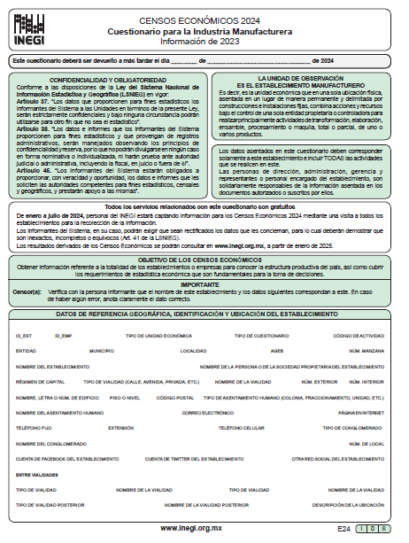
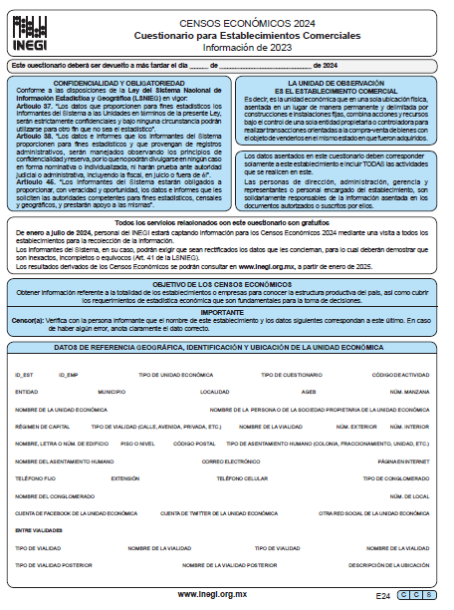
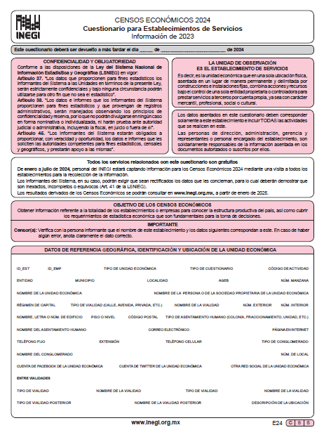
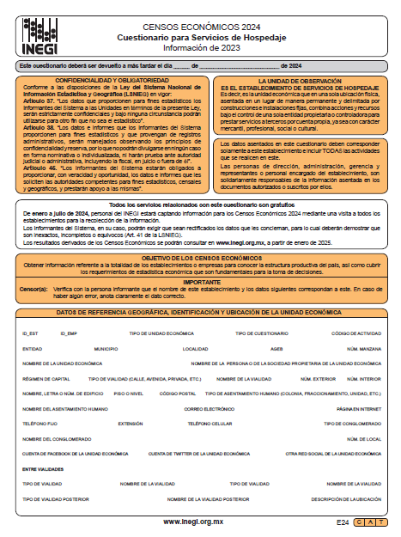
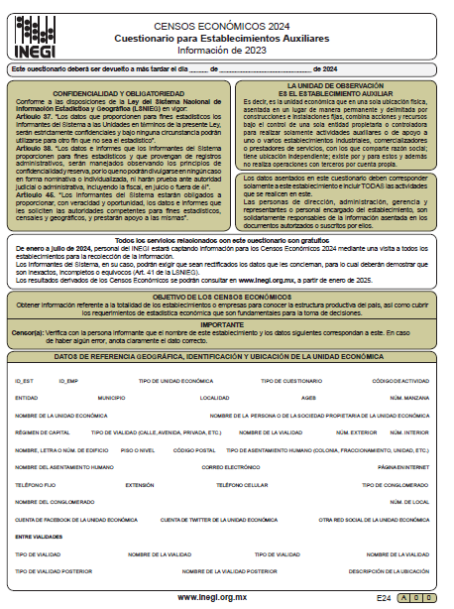
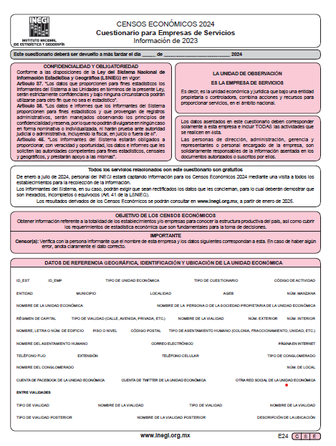
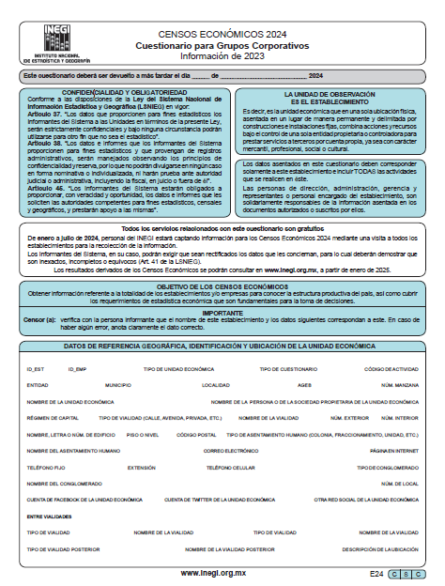
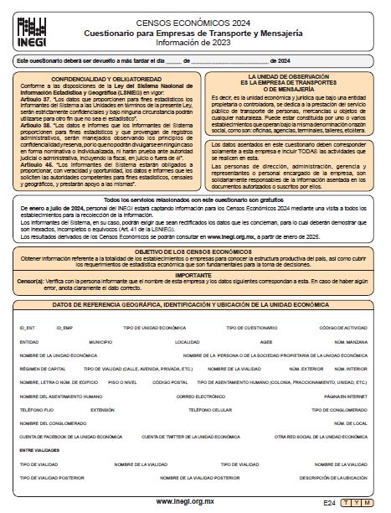
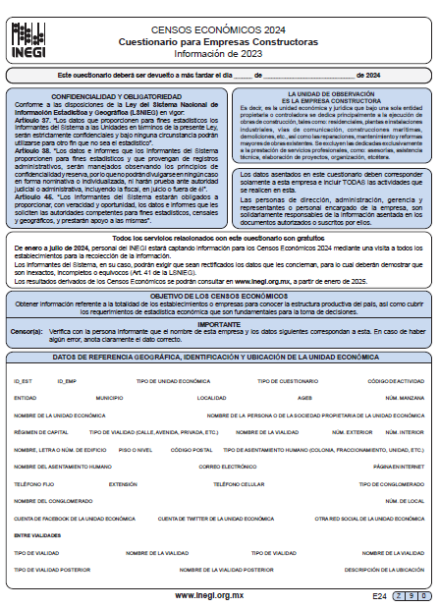
QUESTIONNAIRES USED FOR
ECONOMIC CENSUSES
Basic questionnaire
Manufacturing industry
Commercial establishments
Service establishments
Service enterprises
Accommodation services
Banking, credit, and securities market institutions
Insurance institutions
Corporate groups
Transportation and courier companies
Pipeline transportation and distribution companies
Construction companies
Mining units
Fisheries or aquaculture units
Electrical industry
Water supply companies
Crude oil and natural gas extraction activities
Auxiliary establishments

Slide 8

ECONOMIC CENSUSES:
A LARGE-SCALE PROJECT
More than 32,000 people were hired
More than 1.6 million blocks were covered
More than 40,000 locations were visited
18 questionnaires
All localities with 2,500 inhabitants or more were covered
Municipal seats, industrial and tourist corridors were visited.
Among these 1.6 million blocks, there are 10 blocks with a perimeter of more than 25 kilometers. The largest one, located in the port of Lázaro Cárdenas, has a total perimeter of 54 kilometers. This route is our initial protocol in each block of the country.

Slide 9
USE OF INFORMATION
Public sector
Private sector
Academic sector
  Federal, state, and municipal governments will have useful information for:
    Planning and evaluating economic policies
    Measuring the impact of government policies on the economy
    Making decisions about programs and projects that benefit the population
Mexican entrepreneurs will have information that allows them to understand and evaluate the economic situation and support their decisions to create, maintain, or grow their business:
  Characteristics of customers and suppliers
  The domestic market
  Trade routes or networks
The academic and research sector will have the tools to study and analyze the characteristics of the national, state, or regional economy, as well as the links between information from the geographical, environmental, or social spheres.

Slide 10
WORK PROGRAM
2024 ECONOMIC CENSUSES
Activity | 2022 | 2023 |  |  |  |  |  |  |  |  |  |  |  | 2024 |  |  |  |  |  |  |  |  |  |  |  | 2025 |  |  |  |  |  |  |  |  |  |  |  | 2026
 |  | J | F | M | A | M | J | J | A | S | O | N | D | J | F | M | A | M | J | J | A | S | O | N | D | J | F | M | A | M | J | J | A | S | O | N | D
General planning
Public consultation
Pilot test
Update and verification of the Priority Business Group
Training and information gathering Rural sample
Training and information gathering Working groups^{1/}
Processing of information Timely results
Timely results
Processing of information Final results
Final results
Tools, dissemination documents
Evaluation
JAN-SEPT
OCT-NOV
17-18
03
31
17
08
13
31
23
24
^{1/} Includes: massive operational, construction, transportation, fishing-mining and priority business groups.

Slide 11


WORK PROGRAM
2024 ECONOMIC CENSUSES
OCT – NOV
2022
Public consultation
JuL – OCT
2023
Update of the Priority Business Group
JAN – MAY
2024
Pre-count
Massive operation data collection
jan
2025
Timely results
APR
2023
Pilot test
NOV – DEC
2023
Rural sample collection
MAY – AUG
2024
Collection of information on Priority Business Group, Fishing, Mining, Transportation and Construction
JUL
2025
Final results

Slide 12
EXAMPLES OF INFORMATION RESULTS

Slide 13
PRIVATE SECTOR AND STATE-OWNED ENTERPRISES
2023
5 468 180
Economic units
27 965 433
Employed persons

Slide 14
ECONOMIC UNITS, EMPLOYED PERSONS, AND GROSS CENSAL ADDED VALUE
2023
Percentage
Gross censal added value
Economic
units
Employed
persons
Total
15 698 352
million pesos
Total
5 468 180
Total
27 965 433
Micro
(0 to 10 employees)
SMEs
(11 to 250 employees)
Large
(more than 250 employees)
Note: Percentages may not sum to 100 due to rounding.

Slide 15
FEDERAL ENTITIES WITH THE HIGHEST CONTRIBUTION TO GROSS CENSAL ADDED VALUE
2018 and 2023
2
Federal entity | Gross censal added value |  | Personal ocupado
 | 2018 |  | 2023
 | % | Position | % | Position
Ciudad de México | 23.0 | 1 | 22.6 | 1
Nuevo León | 8.7 | 2 | 8.5 | 2
Estado de México | 7.7 | 3 | 7.4 | 3
Jalisco | 6.0 | 4 | 6.0 | 4
Guanajuato | 4.5 | 6 | 5.3 | 5
Nuevo León
8.5 %
1
Ciudad de México
22.6 %
4
Jalisco
6.0 %
5
Guanajuato
5.3 %
3
Estado de México
7.4 %
Notes:
Nota: cinco entidades generan 49.8 % del valor agregado censal bruto total.
Los datos de 2018 se tomaron de los tabulados con datos corrientes.

Slide 16
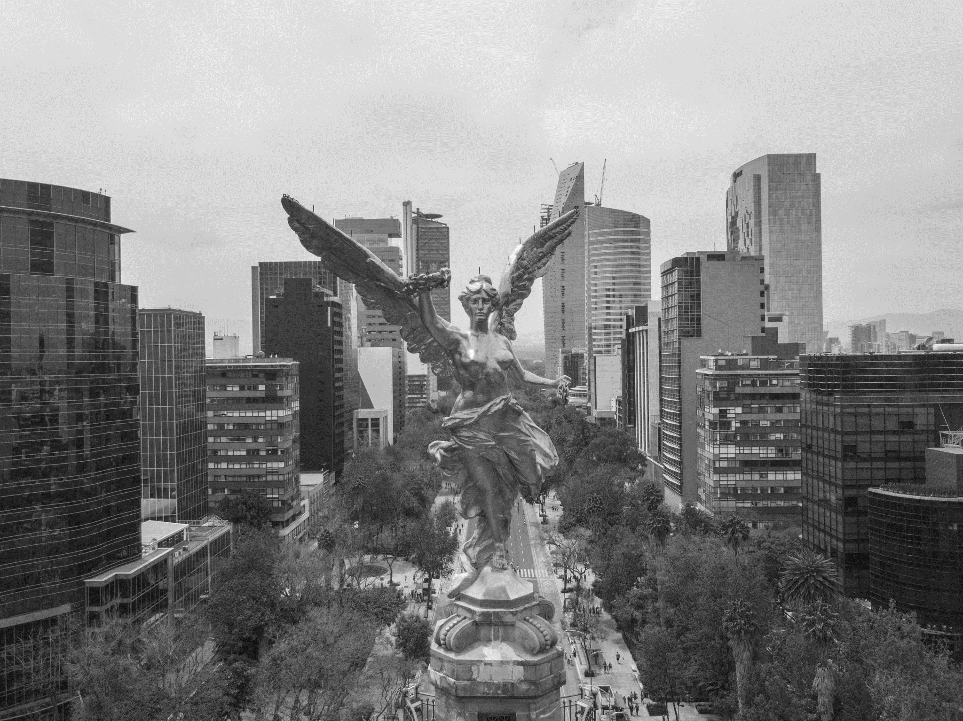
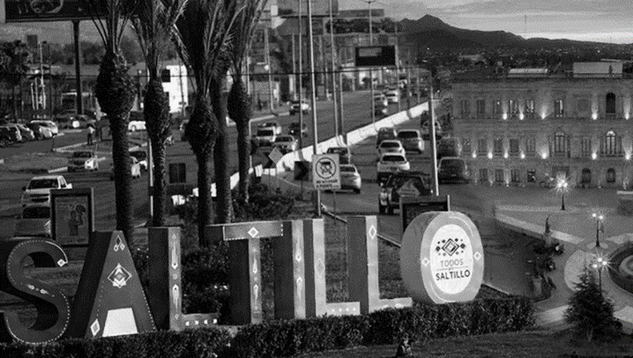
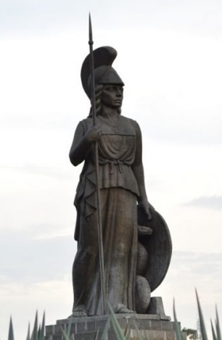

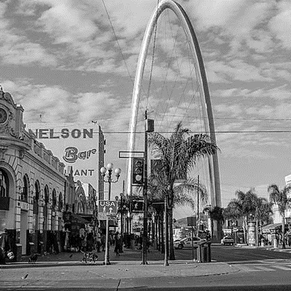
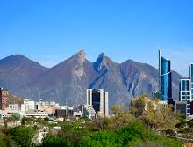
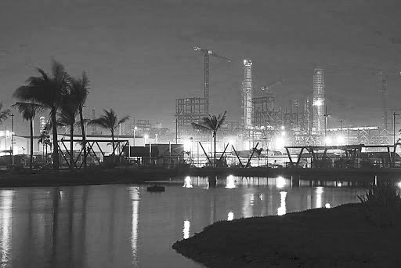
MUNICIPALITIES WITH THE HIGHEST CONTRIBUTION TO GROSS CENSAL ADDED VALUE
2018 and 2023
No. | Municipality | Gross censal added value |  | Personal ocupado
 |  | 2018 |  | 2023
 |  | % | Position | % | Position
1 | Cuauhtémoc, Ciudad de México | 8.7 | 1 | 8.5 | 1
2 | Miguel Hidalgo, Ciudad de México | 3.9 | 3 | 4.5 | 2
3 | Álvaro Obregón, Ciudad de México | 3.3 | 4 | 2.7 | 3
4 | Monterrey, Nuevo León | 3.2 | 5 | 2.4 | 4
5 | Carmen, Campeche | 5.3 | 2 | 2.0 | 5
6 | Tijuana, Baja California | 1.6 | 8 | 1.9 | 6
7 | Benito Juárez, Ciudad de México | 1.5 | 9 | 1.9 | 7
8 | Saltillo, Coahuila | 1.2 | 16 | 1.9 | 8
9 | Guadalajara, Jalisco | 2.0 | 7 | 1.7 | 9
10 | Paraíso, Tabasco | 2.0 | 6 | 1.7 | 10

Slide 17




ECONOMIC ACTIVITIES WITH THE HIGHEST INCREASE IN EMPLOYED PERSONS
No. | Class of economic activity | Difference between 2018 and 2023 (persons) | Average annual growth rate (percentage)
1 | Retail trade in grocery stores | 216 191 | 4.1
2 | Full-service restaurants | 108 579 | 6.3
3 | Beauty salons, spas, and barbershops | 104 780 | 6.0
4 | General freight trucking, long-distance, truckload^{1/} | 90 592 | 10.0
5 | Manufacture of electrical and electronic equipment and parts for motor vehicles | 79 865 | 3.4
6 | Pharmacies and drug retailers | 73 880 | 7.8
7 | Retail clothing trade, except baby and lingerie | 72 886 | 4.5
8 | Limited-service restaurants | 68 632 | 3.7
9 | Snack and nonalcoholic beverage bars | 67 391 | 5.7
10 | Construction of electric and railway transportation infrastructure | 54 046 | 68.0
^{1/} Excludes long-distance transport of agricultural products

Slide 18

CONSULT THE FINAL RESULTS OF THE
2024 ECONOMIC CENSUSES
https://www.inegi.org.mx/programas/ce/2024/

